Slide 1
BAN 502 – Module 6 Hierarchical Clustering
Dr. Avinash Geda

Slide 2
Hierarchical Clustering
Two Types
Agglomerative → Each observation starts as its own cluster → Similar observations are then clustered → Continues until there is a single cluster of all observations
Divisive → Opposite, start with single cluster and split until each observation is own cluster
Clustering results viewed in a Dendogram

Slide 3
Hierarchical Clustering
Before beginning:
No missingness
Scaled data

Slide 4
Hierarchical Clustering
Measuring Similarity/Dissimilarity Between Clusters
Complete Linkage → Largest of pairwise dissimilarities between clusters → Creates compact clusters
Single Linkage → Same as Complete, but with smallest dissimilarities → Creates loose clusters

Slide 5
Hierarchical Clustering
Measuring Similarity/Dissimilarity Between Clusters
Mean Linkage → Average of pairwise dissimilarities
Centroid→ Dissimilarity measured between centroids
Ward’s → Minimize within-cluster variance

Slide 6
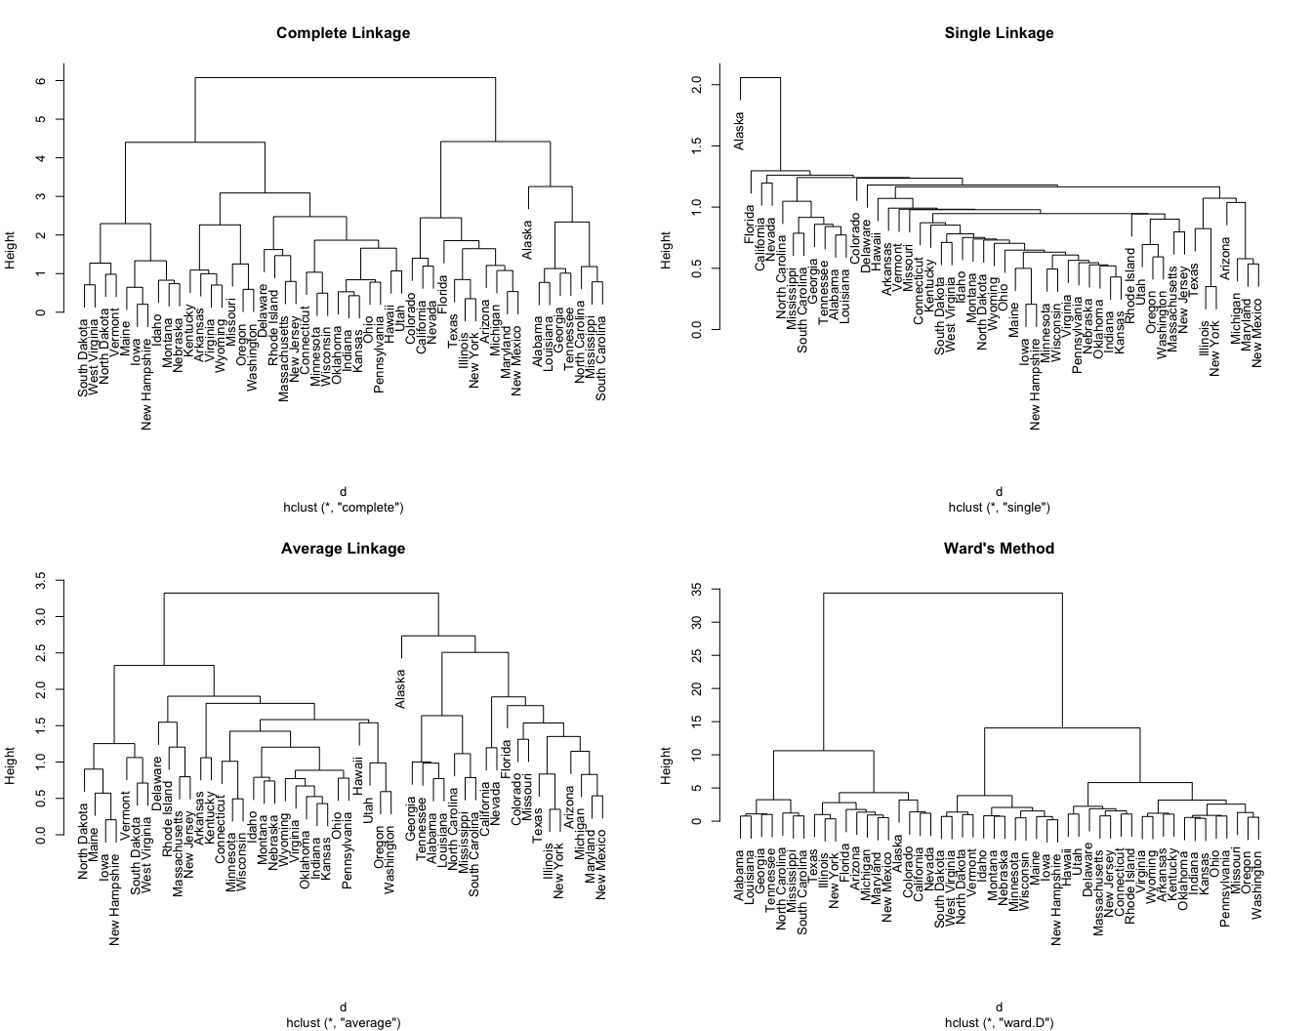
Hierarchical Clustering
Image Source: https://uc-r.github.io/hc_clustering

Slide 7
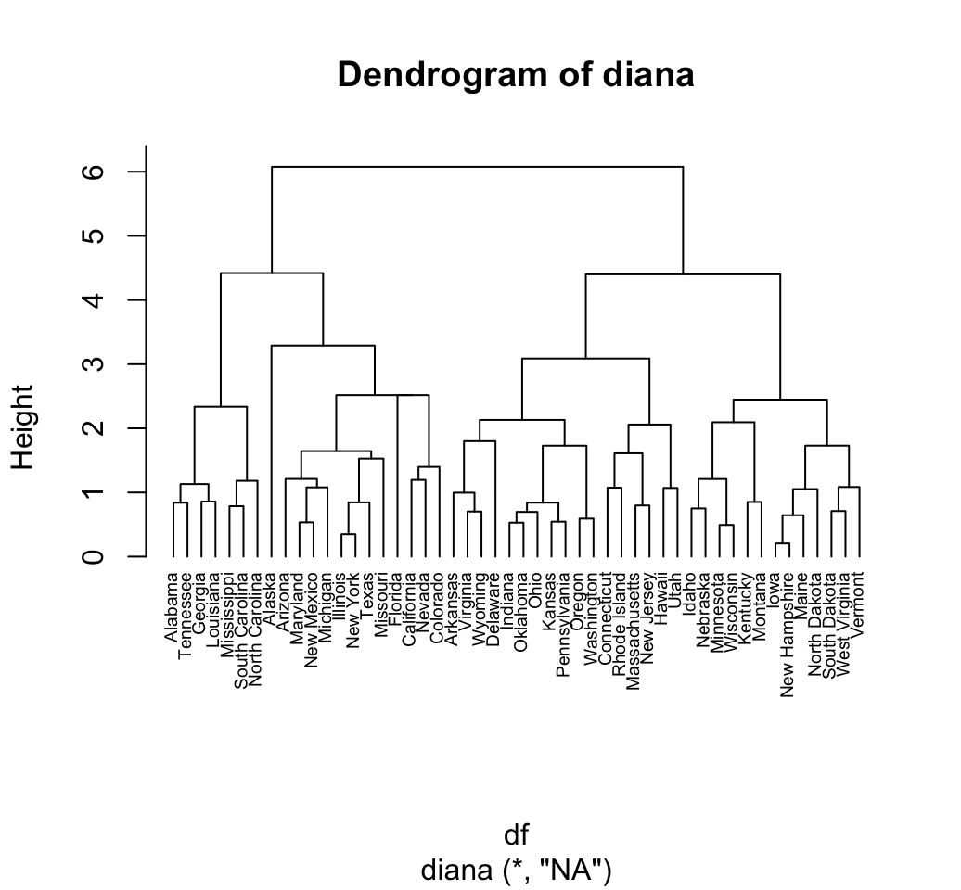
Hierarchical Clustering in Software

